Slide 1


Azərbaycan Dövlət Neft və Sənaye Universiteti
Numerical Methods I

Slide 2
Problem Solving
with
Software Packages

Slide 3
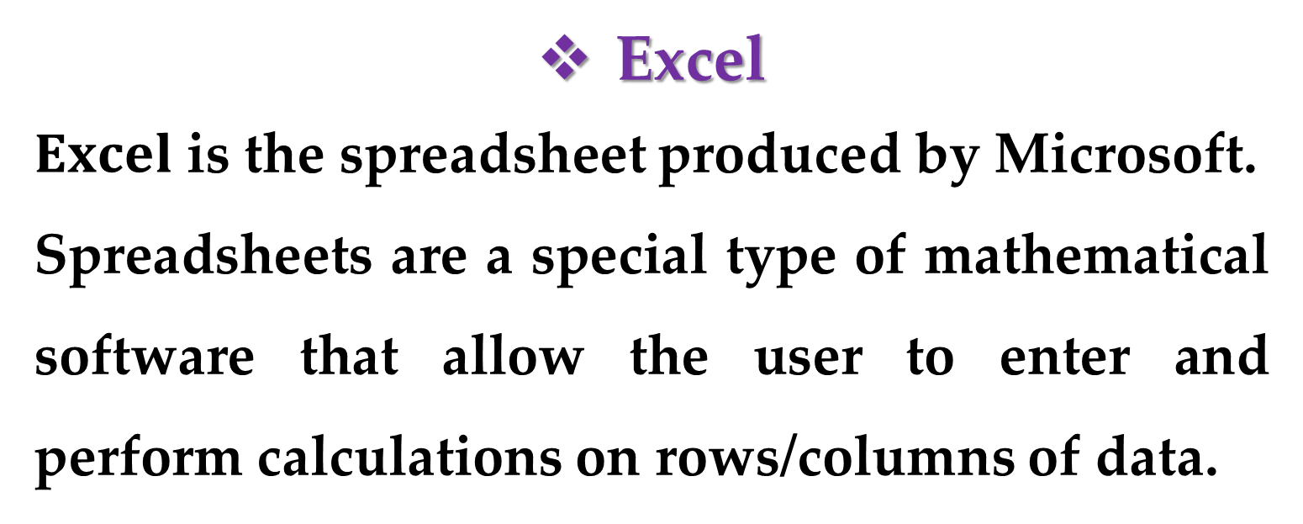
Excel
$Excel$ is the spreadsheet produced by Microsoft.
Spreadsheets are a special type of mathematical software that allow the user to enter and perform calculations on rows/columns of data.
As such, they are a computerized version of a large accounting worksheet on which large interconnected calculations can be implemented and displayed.

Slide 4
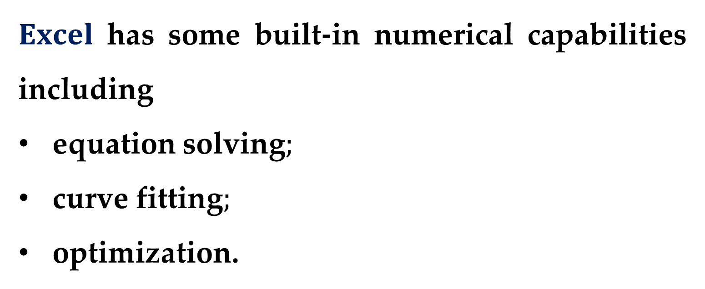
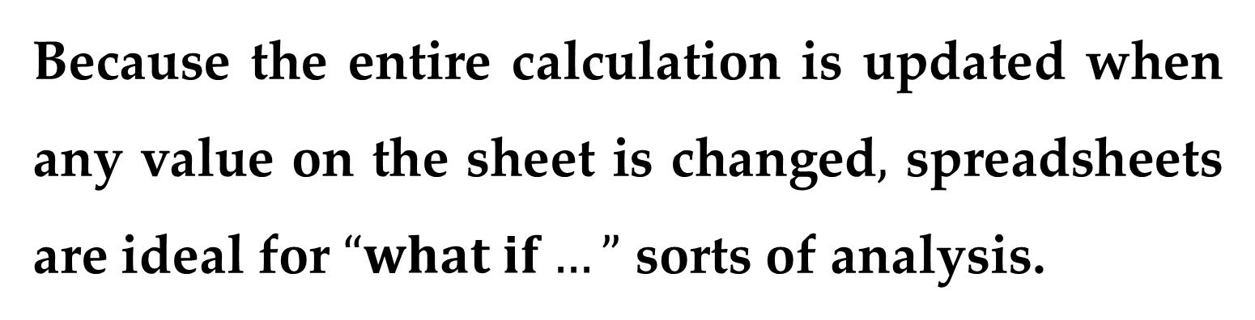
Because the entire calculation is updated when any value on the sheet is changed$,$ spreadsheets are ideal for $“what if…”$ sorts of analysis.
$Excel$ has some built-in numerical capabilities including
equation solving$;$
curve fitting$;$
optimization.

Slide 5
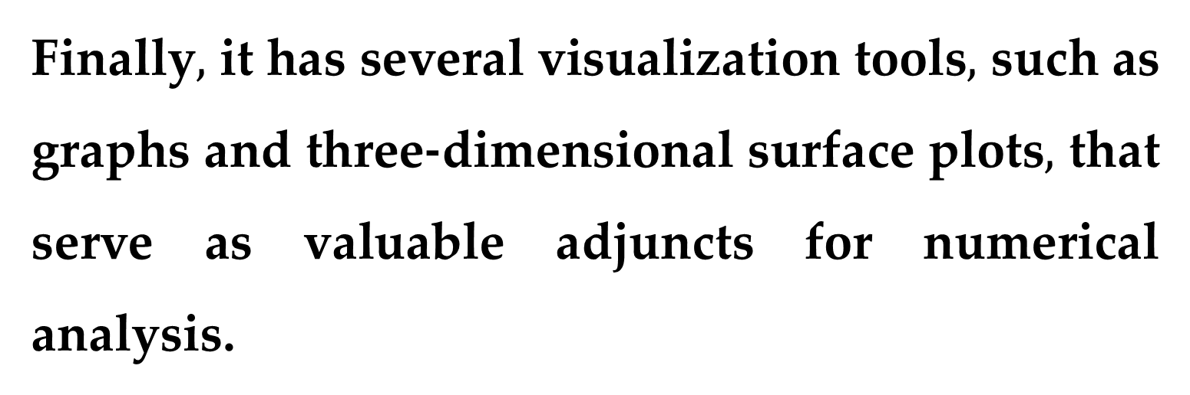
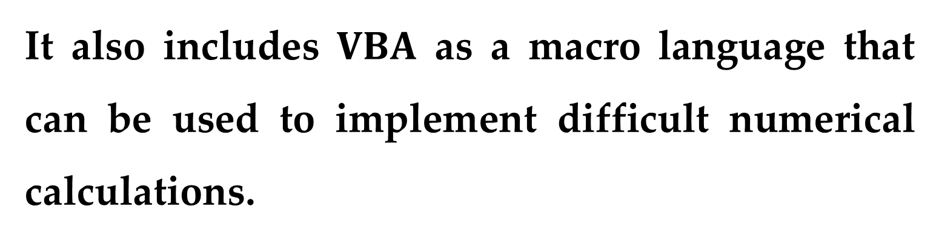
It also includes $VBA$ as a macro language that can be used to implement difficult numerical calculations.
Finally$,$ it has several visualization tools$,$ such as graphs and three-dimensional surface plots$,$ that serve as valuable adjuncts for numerical analysis.

Slide 6
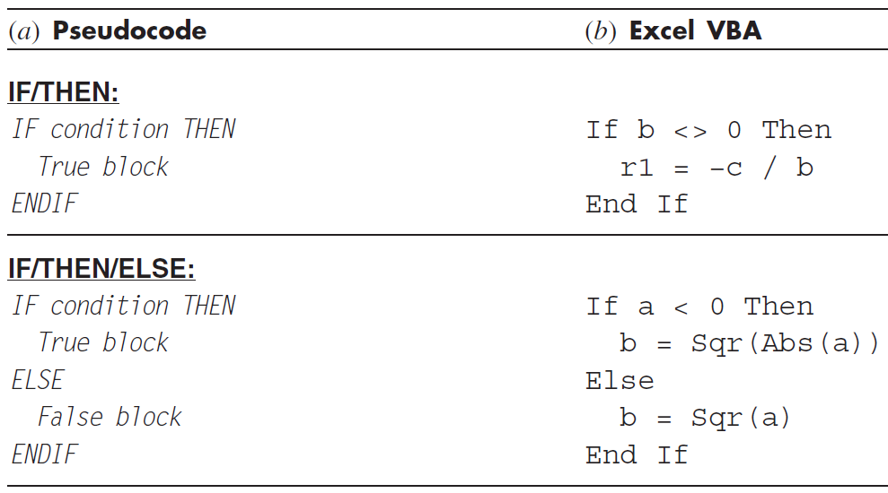
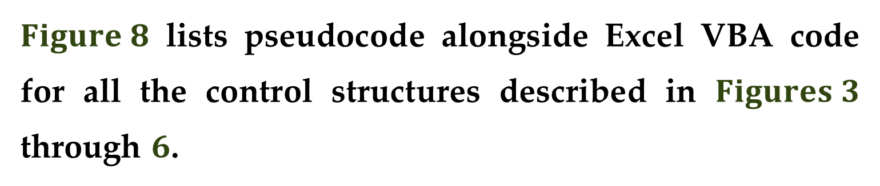
$Figure 8$ lists pseudocode alongside Excel VBA code for all the control structures described in $Figures 3$ through $6$.

Slide 7
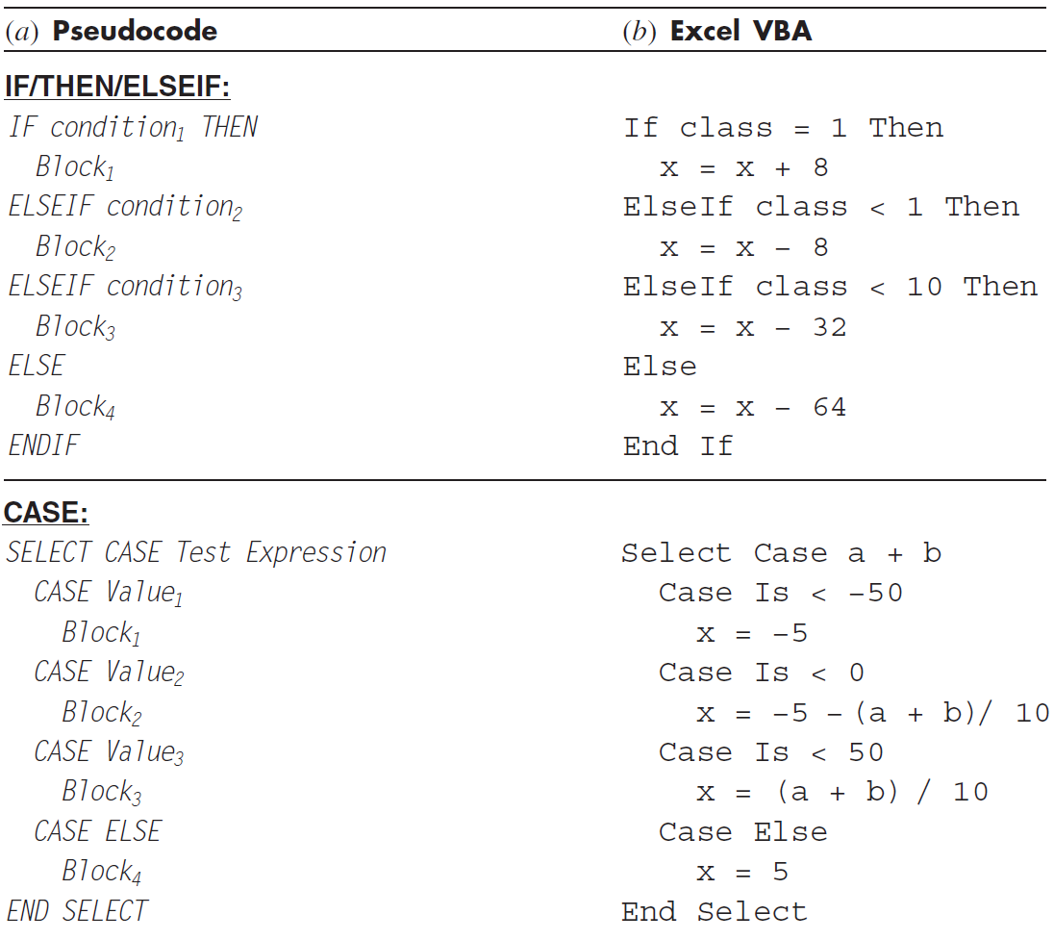

Slide 8
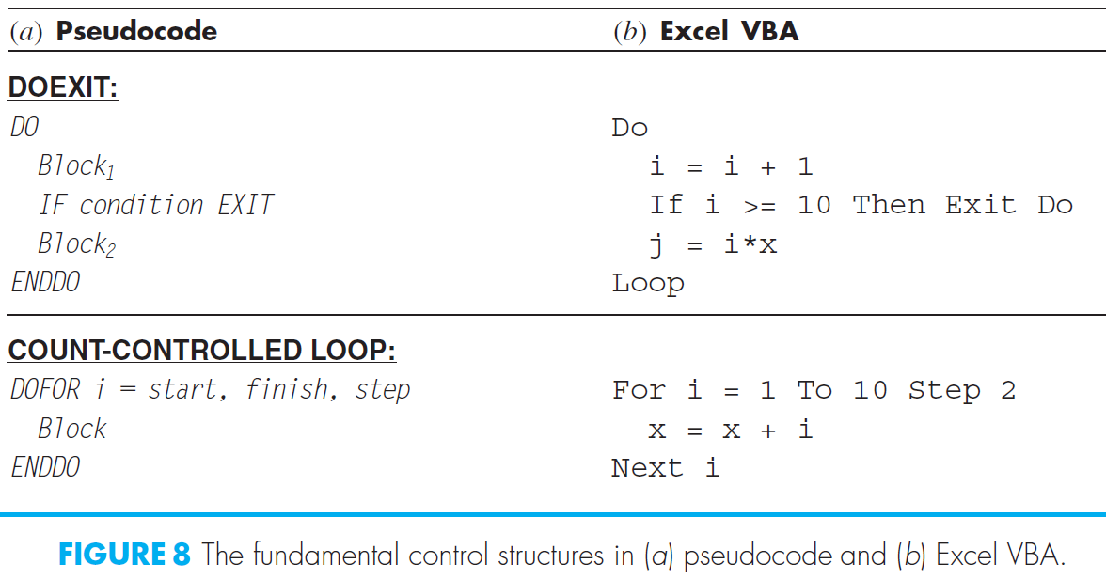
Notice how, although the details differ, the structure of the pseudocode and the VBA code are identical.

Slide 9
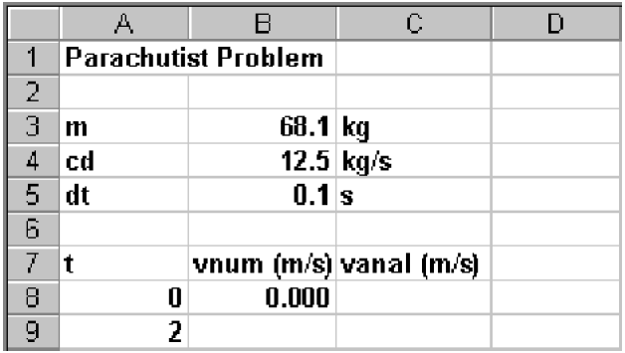
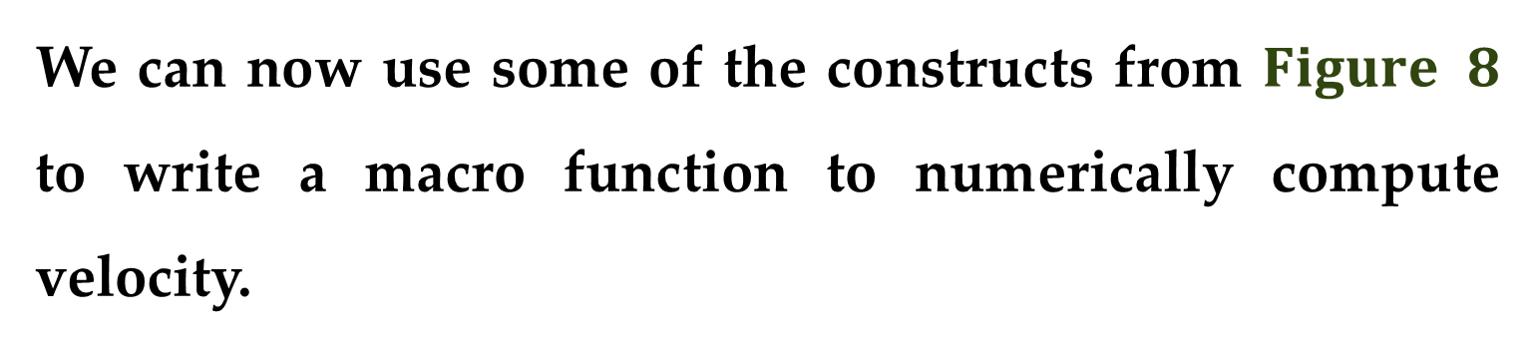
We can now use some of the constructs from $Figure 8$ to write a macro function to numerically compute velocity.
To do this, let us first set up a simple spreadsheet.
As shown here, the first step involves entering labels and numbers into
the spreadsheet
cells.

Slide 10
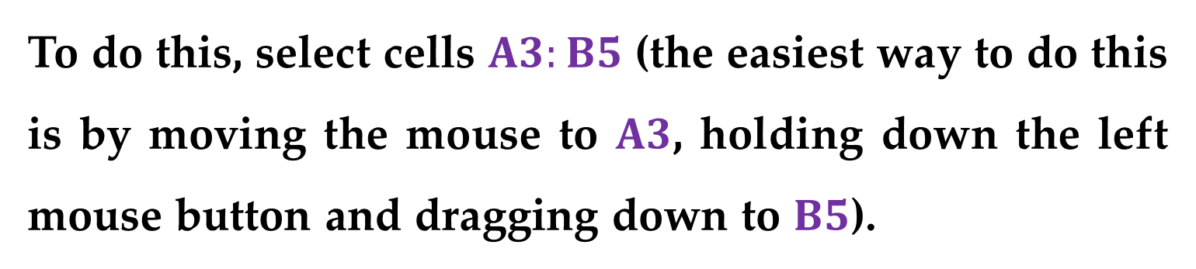
Before we write a macro program to calculate the numerical value, we can make our subsequent work easier by attaching names to the parameter values.
To do this, select cells $A3:B5$ (the easiest way to do this is by moving the mouse to $A3$, holding down the left mouse button and dragging down to $B5$).
Next, go to the Formulas tab and in the Defined Names group, click Create from Selection. This will open the Create Names from Selection dialog box, where the Left column box should be automatically selected.

Slide 11
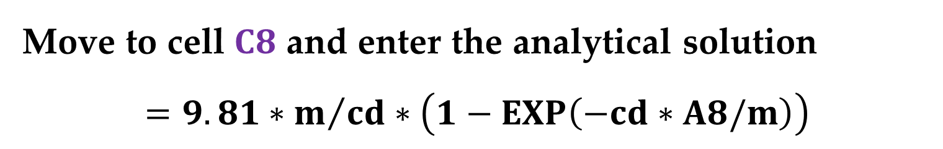
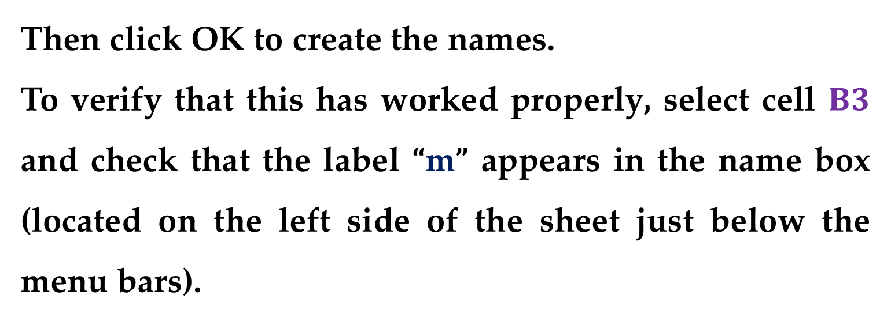
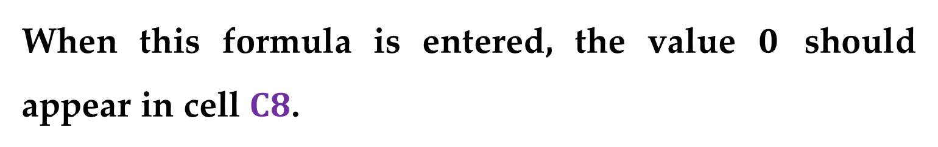
Then click OK to create the names.
To verify that this has worked properly, select cell $B3$ and check that the label “m” appears in the name box (located on the left side of the sheet just below the menu bars).
Move to cell $C8$ and enter the analytical solution
$$=9.81∗m/{cd}∗\left(1−EXP\left(−cd∗A8/m\right)\right)$$
When this formula is entered, the value $0$ should appear in cell $C8$.

Slide 12

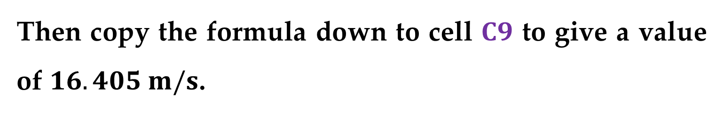
Then copy the formula down to cell $C9$ to give a value of $16.405 m/s$.
All the above is typical of the standard use of Excel.
For example, at this point you could change parameter values and see how the analytical solution changes.
Now, we will illustrate how VBA macros can be used to extend the standard capabilities.
Open VBA by selecting
$$Tools → Macro → Visual Basic Editor$$

Slide 13
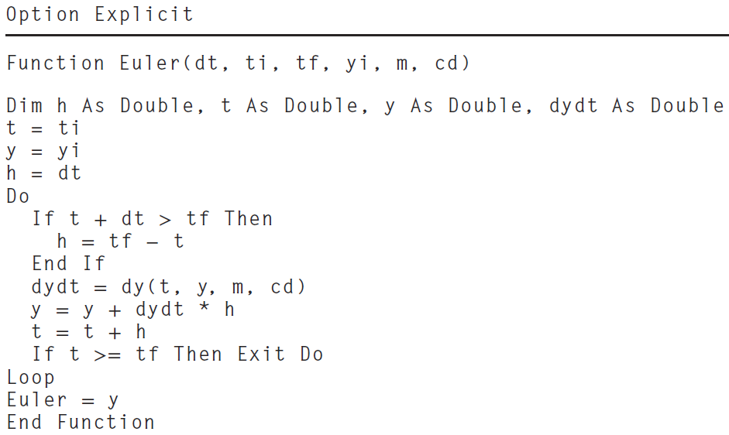
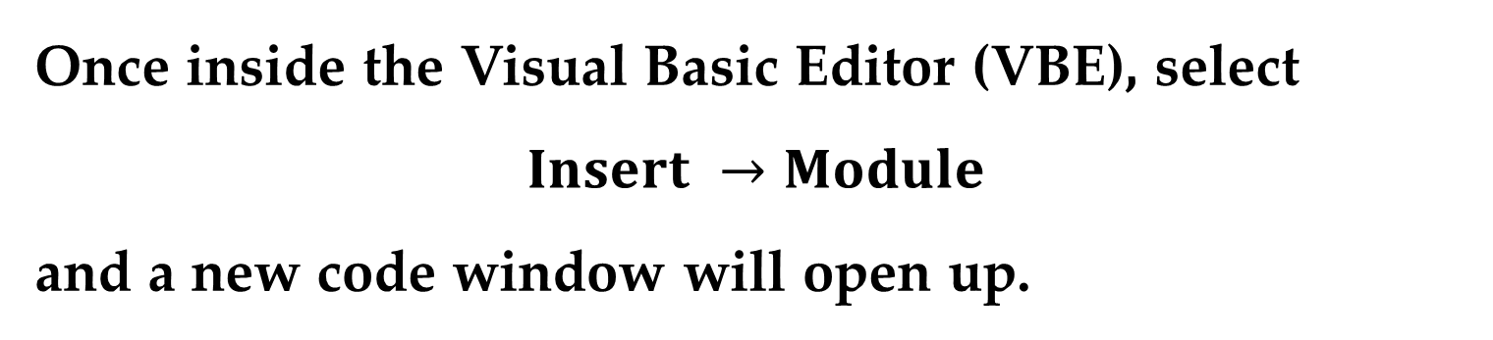
Once inside the Visual Basic Editor (VBE), select
$$Insert →Module$$
and a new code window will open up.
Type the following code into the code window.

Slide 14
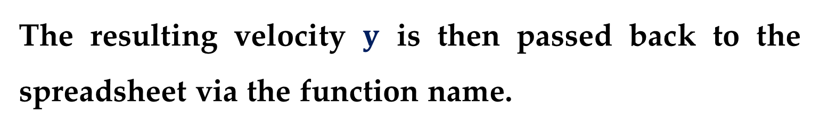
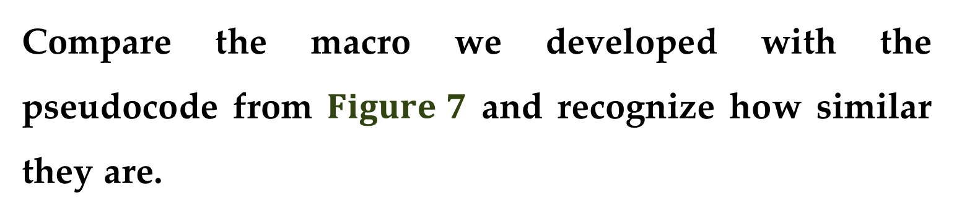
Compare the macro we developed with the pseudocode from $Figure 7$ and recognize how similar they are.
Also, see how we have expanded the function’s argument list to include the necessary parameters for the parachutist velocity model.
The resulting velocity $y$ is then passed back to the spreadsheet via the function name.

Slide 15
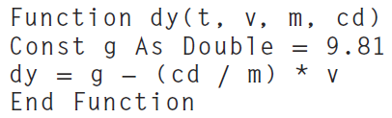
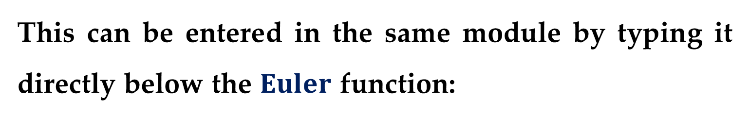
Also notice how we have included another function to compute the derivative.
This can be entered in the same module by typing it directly below the $Euler$ function:
The final step is to return to the spreadsheet and invoke the function by entering the following formula in a cell: =Euler(dt,A8,A9,B8,m,cd)

Slide 16
The result of the numerical integration will appear in this cell.
When you enter the function into the spreadsheet cell, the parameters are passed into the VBA program where the calculation is performed and the result is then passed back and displayed in the cell.
In effect, the VBA macro language allows you to use Excel as your input/output mechanism.
All sorts of benefits arise from this fact.

Slide 17
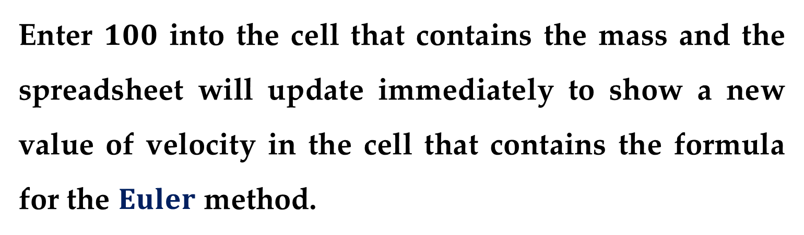
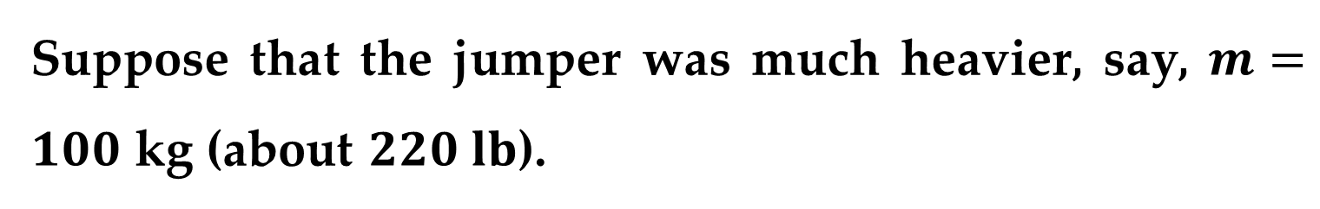
For example, now that you have set up the calculation, you can play with it.
Suppose that the jumper was much heavier, say, $m=100$ kg (about $220 lb$).
Enter $100$ into the cell that contains the mass and the spreadsheet will update immediately to show a new value of velocity in the cell that contains the formula for the $Euler$ method.

Slide 18
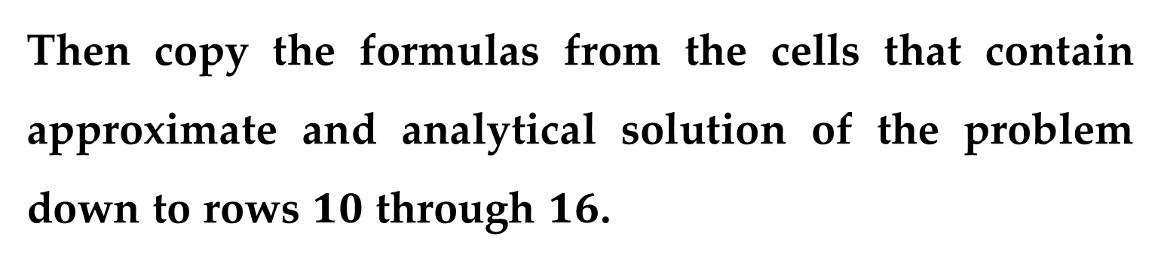
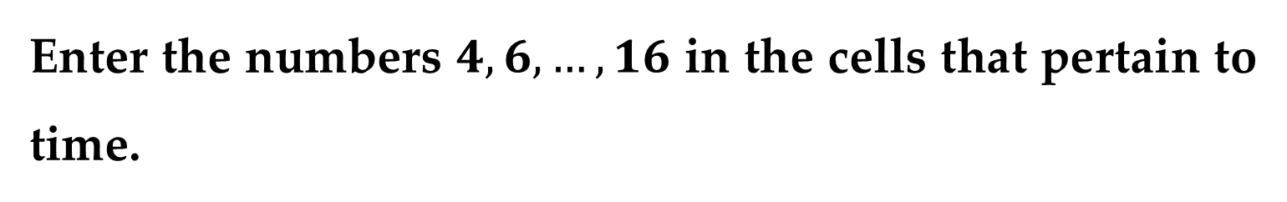
Now let us take the process one step further by filling in some additional numbers for the time.
Enter the numbers $4,6,…,16$ in the cells that pertain to time.
Then copy the formulas from the cells that contain approximate and analytical solution of the problem down to rows $10$ through $16$.
Notice how the VBA program calculates the numerical result correctly for each new row.

Slide 19
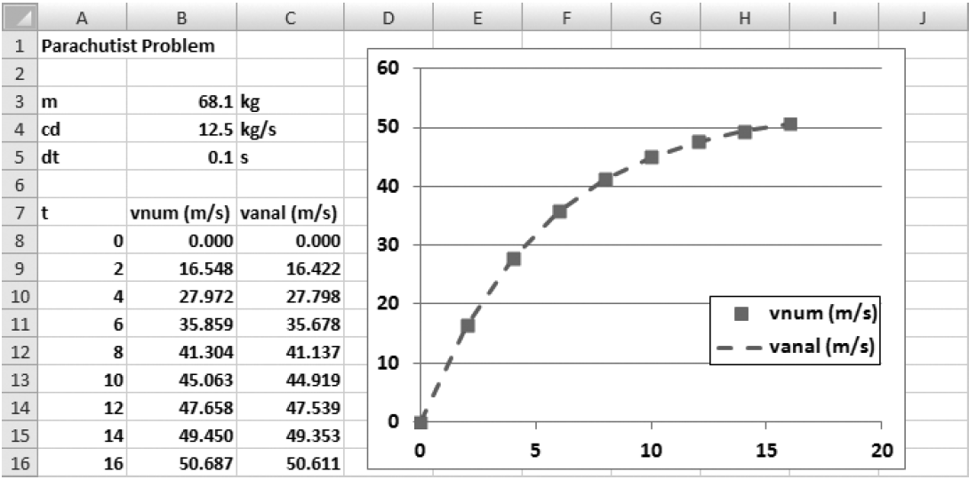
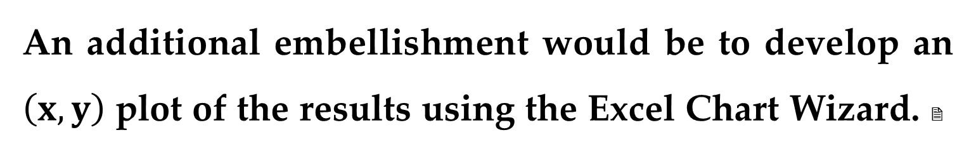
An additional embellishment would be to develop an $\left(x,y\right)$ plot of the results using the Excel Chart Wizard. 
You can perform sensitivity analyses by changing the values for each of the parameters.

Slide 20
As each new value is entered, the computation and the graph would be automatically updated.
It is this interactive nature that makes Excel so powerful.
However, recognize that the ability to solve this problem hinges on being able to write the macro with VBA.

Slide 21
It is the combination of the Excel environment with the VBA programming language that truly opens up a world of possibilities for scientific and engineering problem solving.

Slide 22
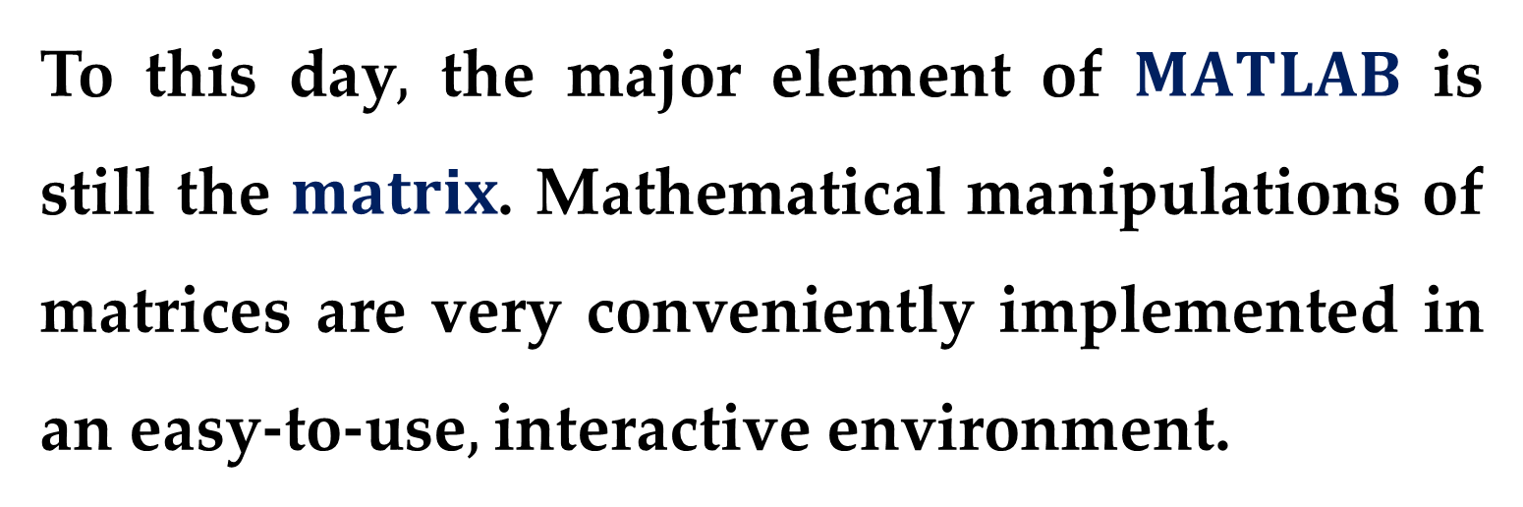
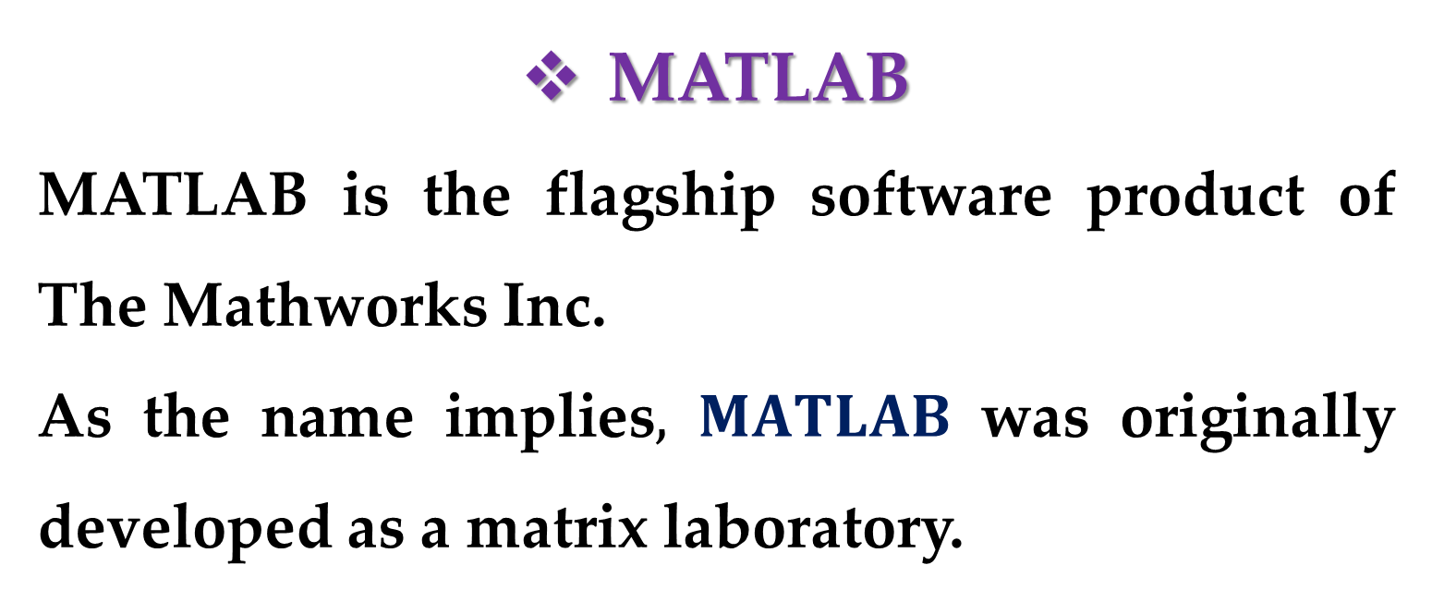
MATLAB
MATLAB is the flagship software product of The Mathworks Inc.
As the name implies$,$ $MATLAB$ was originally developed as a matrix laboratory.
To this day$,$ the major element of $MATLAB$ is still the $matrix$. Mathematical manipulations of matrices are very conveniently implemented in an easy-to-use$,$ interactive environment.

Slide 23
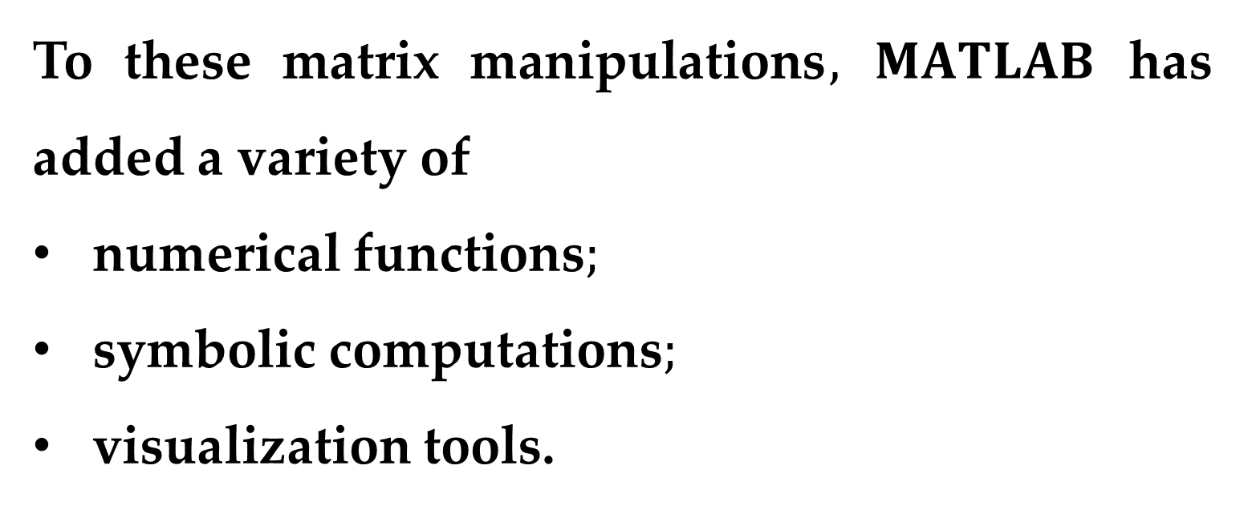
To these matrix manipulations$,$ $MATLAB$ has added a variety of
numerical functions$;$
symbolic computations$;$
visualization tools.
As a consequence, the present version represents a fairly comprehensive technical computing environment.

Slide 24
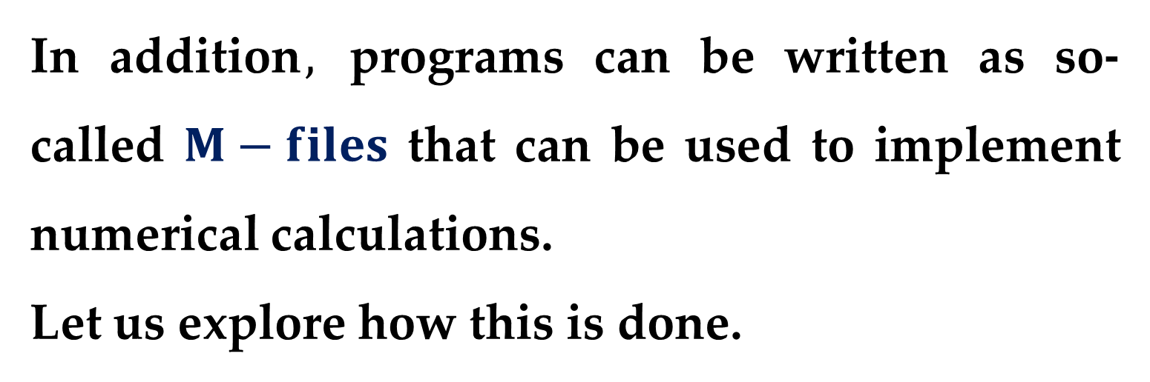
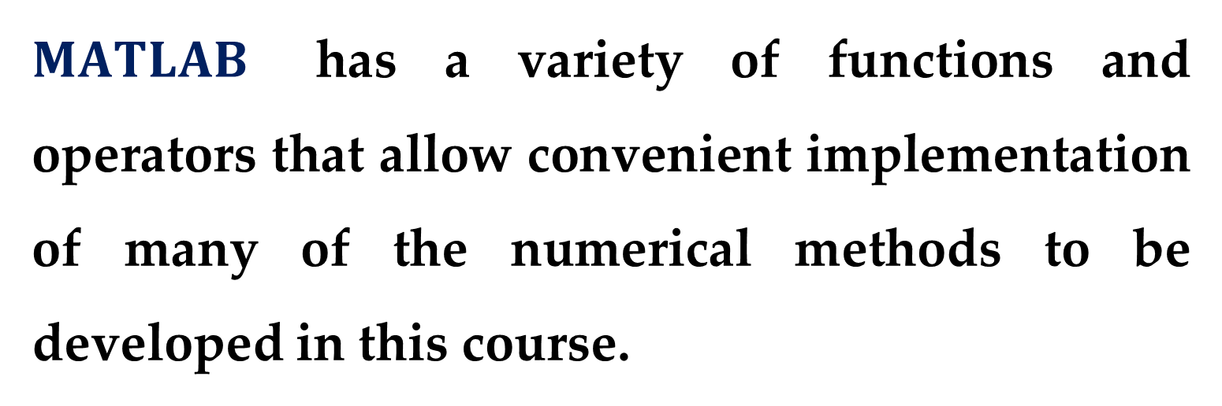
$MATLAB$ has a variety of functions and operators that allow convenient implementation of many of the numerical methods to be developed in this course.
In addition$,$ programs can be written as so- called $M−files$ that can be used to implement numerical calculations.
Let us explore how this is done.

Slide 25
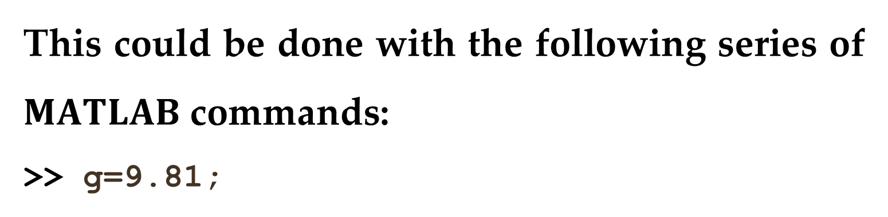
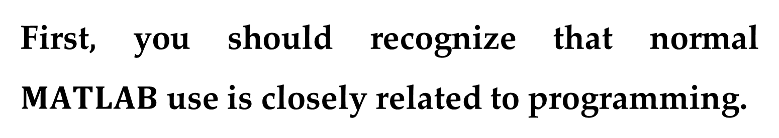
First, you should recognize that normal $MATLAB$ use is closely related to programming.
For example, suppose that we wanted to determine the analytical solution to the parachutist problem.
This could be done with the following series of $MATLAB$ commands:
>> g=9.81;

Slide 26
>> m=68.1;
>> cd=12.5;
>> tf=2;
>> v=g*m/cd*(1−exp(−cd/m*tf))
with the result being displayed as
v =
16.4217
Thus, the sequence of commands is just like the sequence of instructions in a typical programming language.

Slide 27
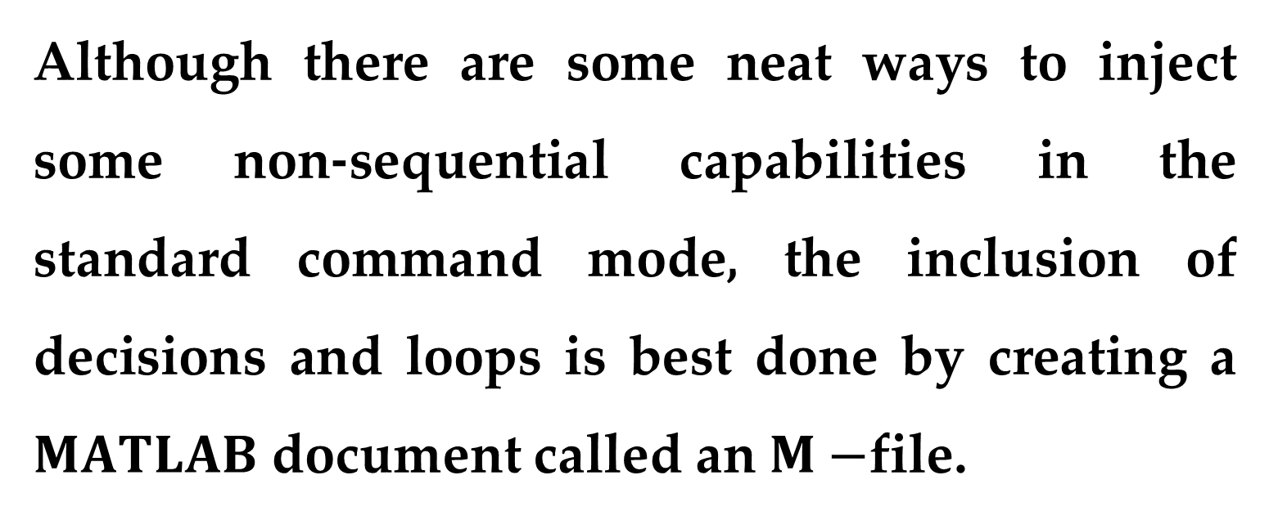
Now what if you want to deviate from the sequential structure.
Although there are some neat ways to inject some non-sequential capabilities in the standard command mode, the inclusion of decisions and loops is best done by creating a $MATLAB$ document called an $M−$file.

Slide 28

To do this, make the menu selection
$$File → New →Script$$
and a new window will open with a heading “MATLAB Editor/Debugger”.
In this window, you can type and edit MATLAB programs.

Slide 29
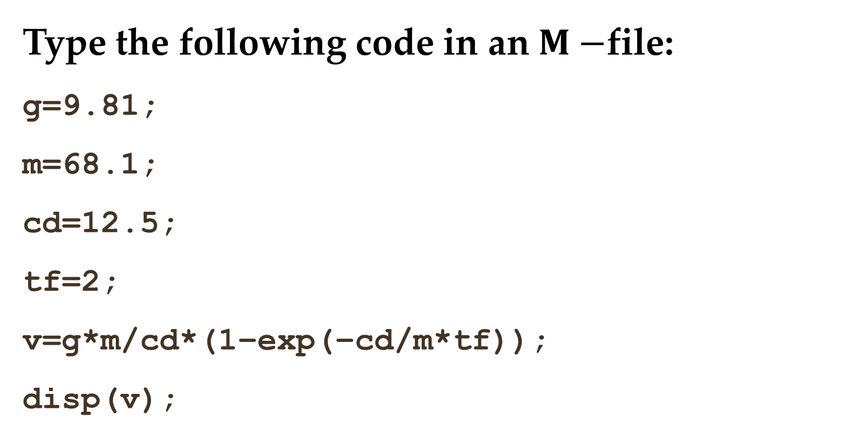
Type the following code in an $M−$file:
g=9.81;
m=68.1;
cd=12.5;
tf=2;
v=g*m/cd*(1−exp(−cd/m*tf));
disp(v);
Notice how the commands are written in exactly the way as they would be written in the front end of MATLAB.

Slide 30
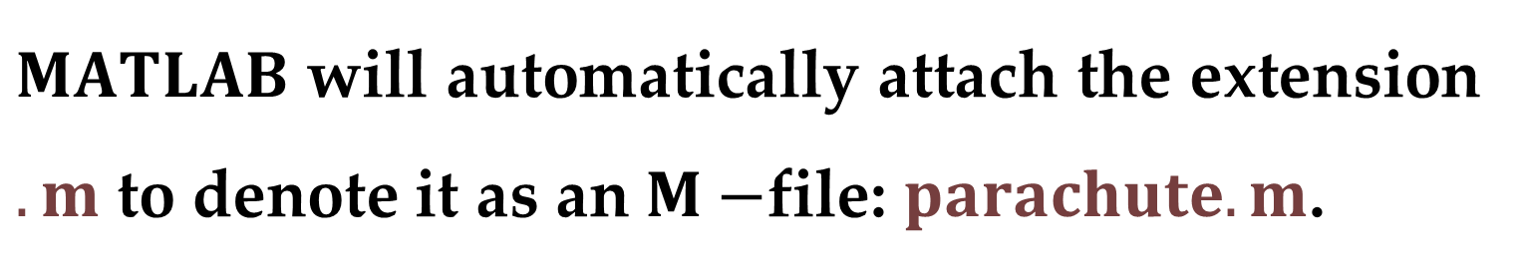

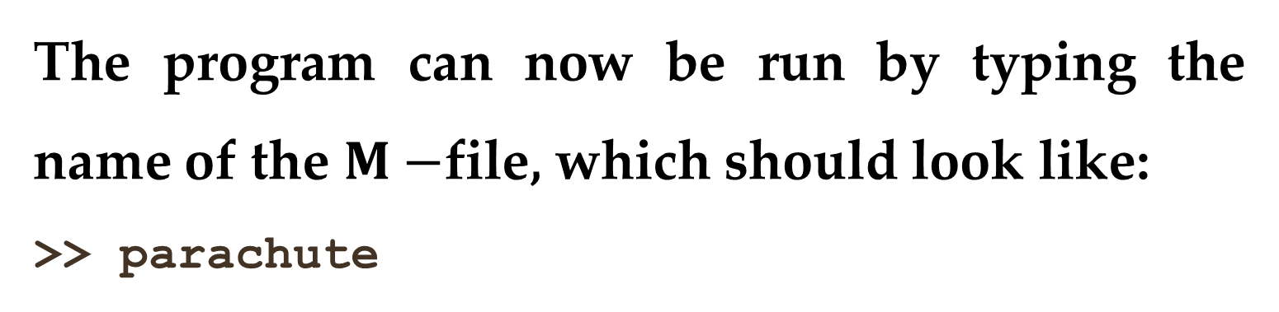
Save the program with the name, e.g. $parachute$.
$MATLAB$ will automatically attach the extension $.m$ to denote it as an $M−$file: $parachute.m$.
To run the program, you must go back to the command mode.
The program can now be run by typing the name of the $M−$file, which should look like:
>> parachute

Slide 31
If you have done everything correctly, MATLAB should respond with the correct answer:
v =
16.4217
Now one problem with the foregoing is that it is set up to compute one case only.
You can make it more flexible by having the user input some of the variables.

Slide 32
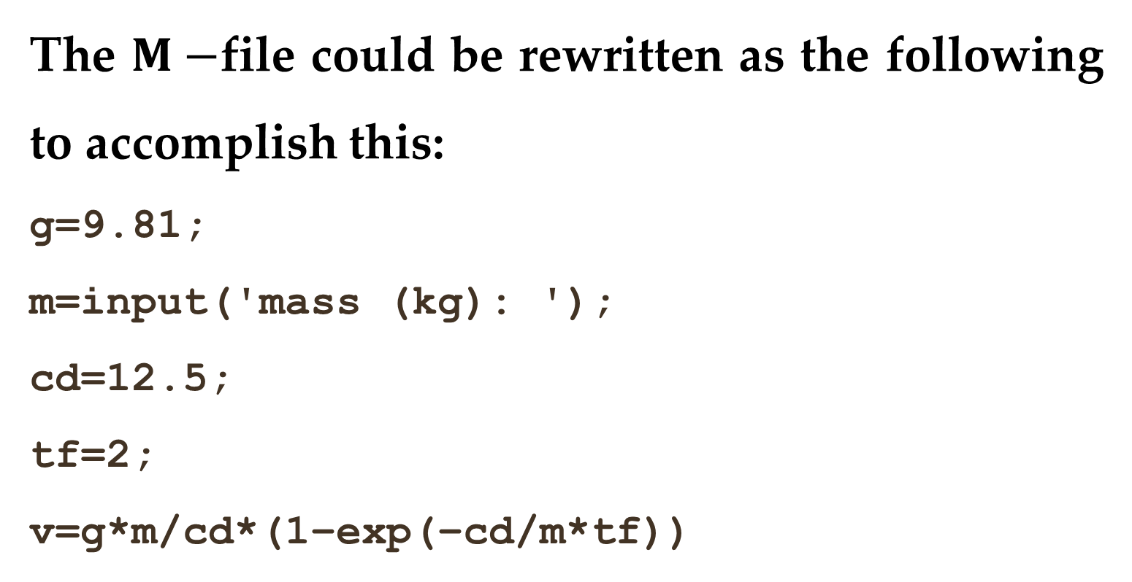
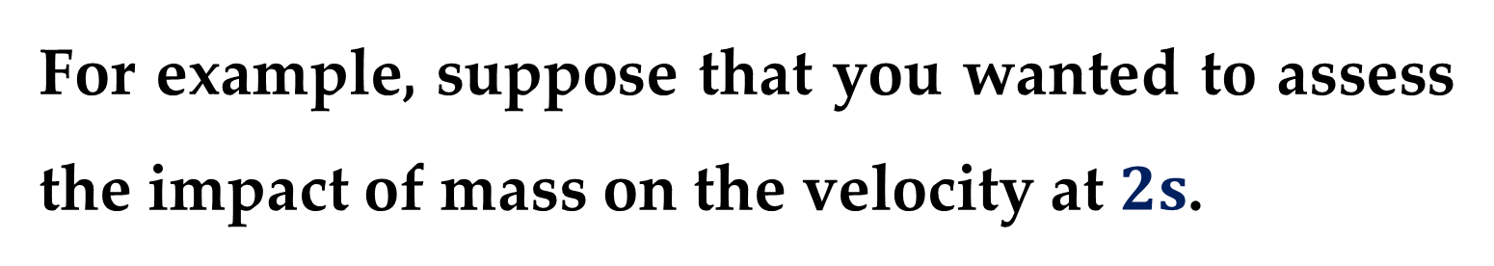
For example, suppose that you wanted to assess the impact of mass on the velocity at $2s$.
The $M−$file could be rewritten as the following to accomplish this:
g=9.81;
m=input('mass (kg): ');
cd=12.5;
tf=2;
v=g*m/cd*(1−exp(−cd/m*tf))

Slide 33
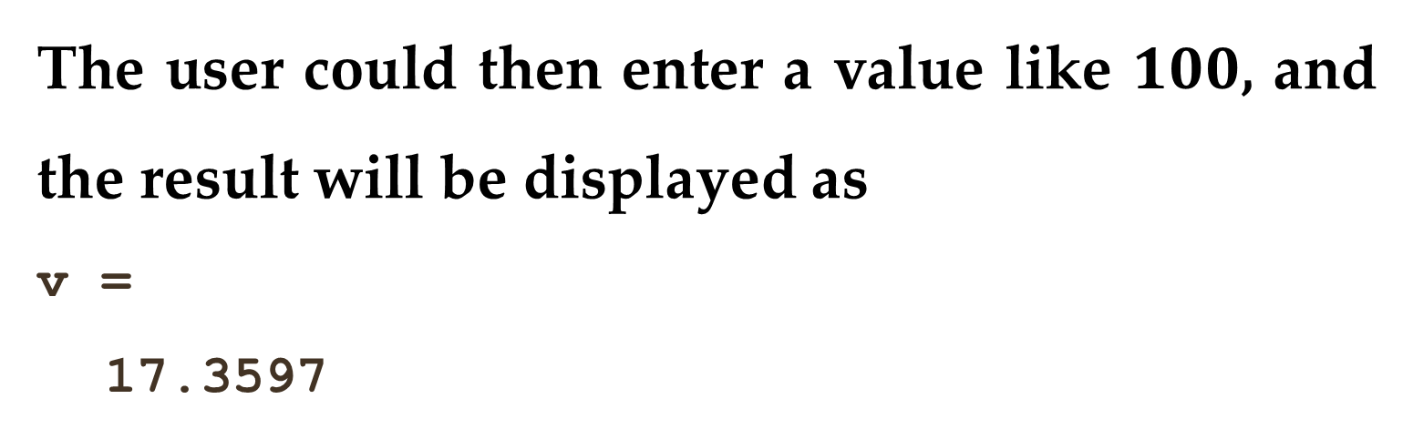
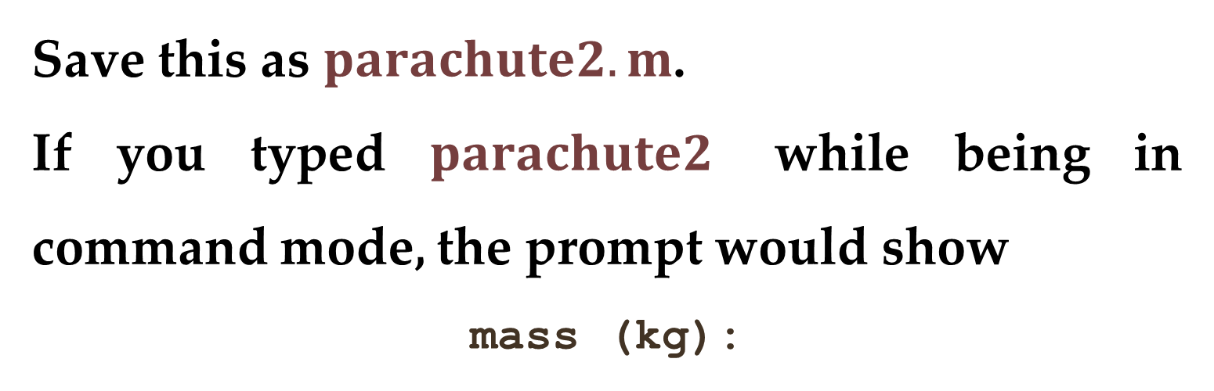
Save this as $parachute2.m$.
If you typed $parachute2$ while being in command mode, the prompt would show
mass (kg):
The user could then enter a value like $100$, and the result will be displayed as
v =
17.3597

Slide 34
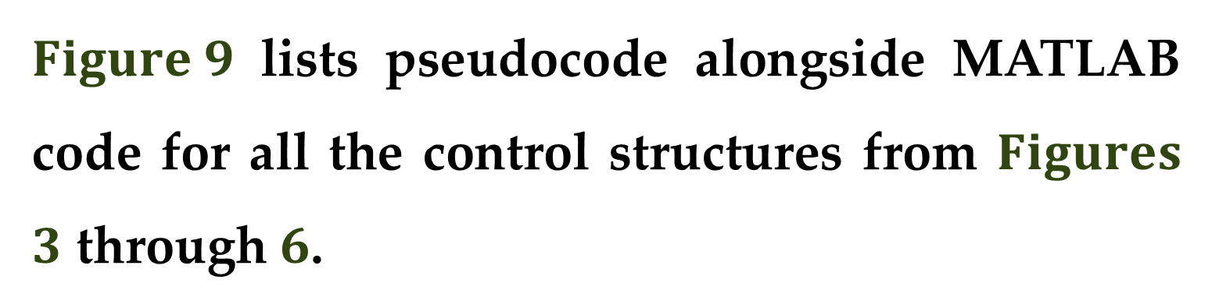
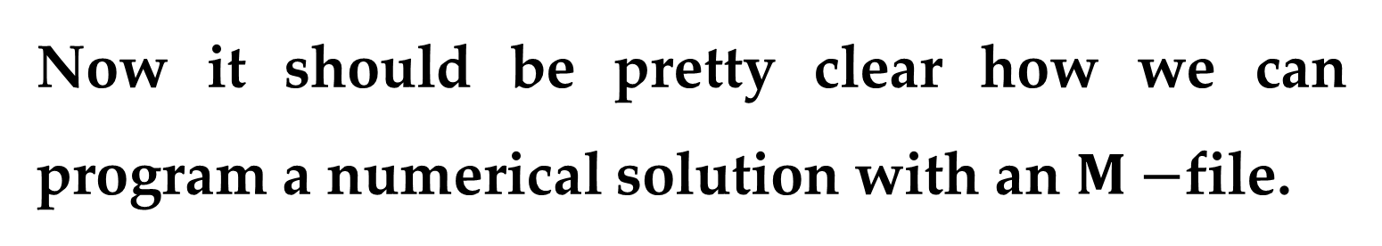
Now it should be pretty clear how we can program a numerical solution with an $M−$file.
In order to do this, we must first understand how MATLAB handles logical and looping structures.
$Figure 9$ lists pseudocode alongside MATLAB code for all the control structures from $Figures$ $3$ through $6$.

Slide 35
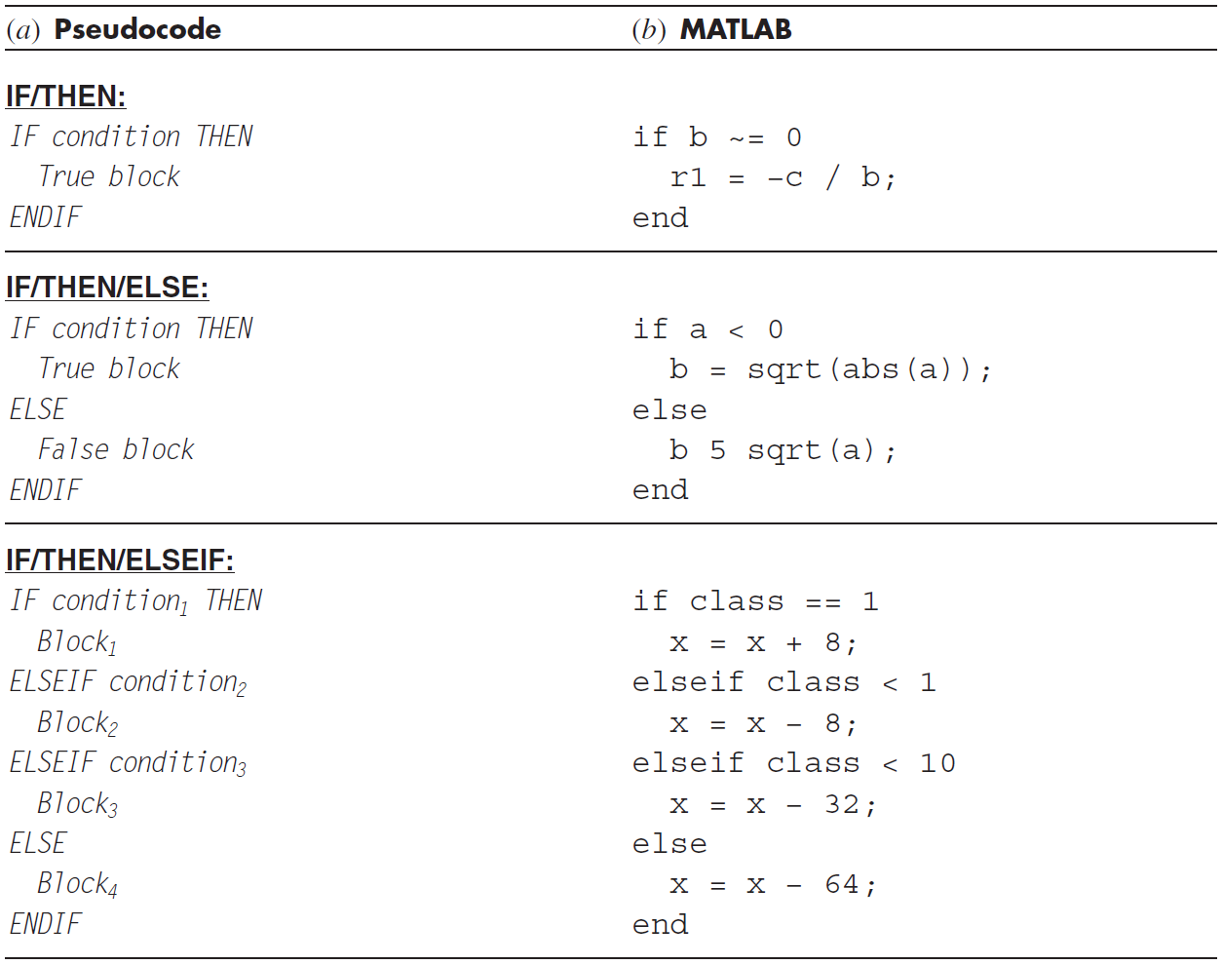

Slide 36
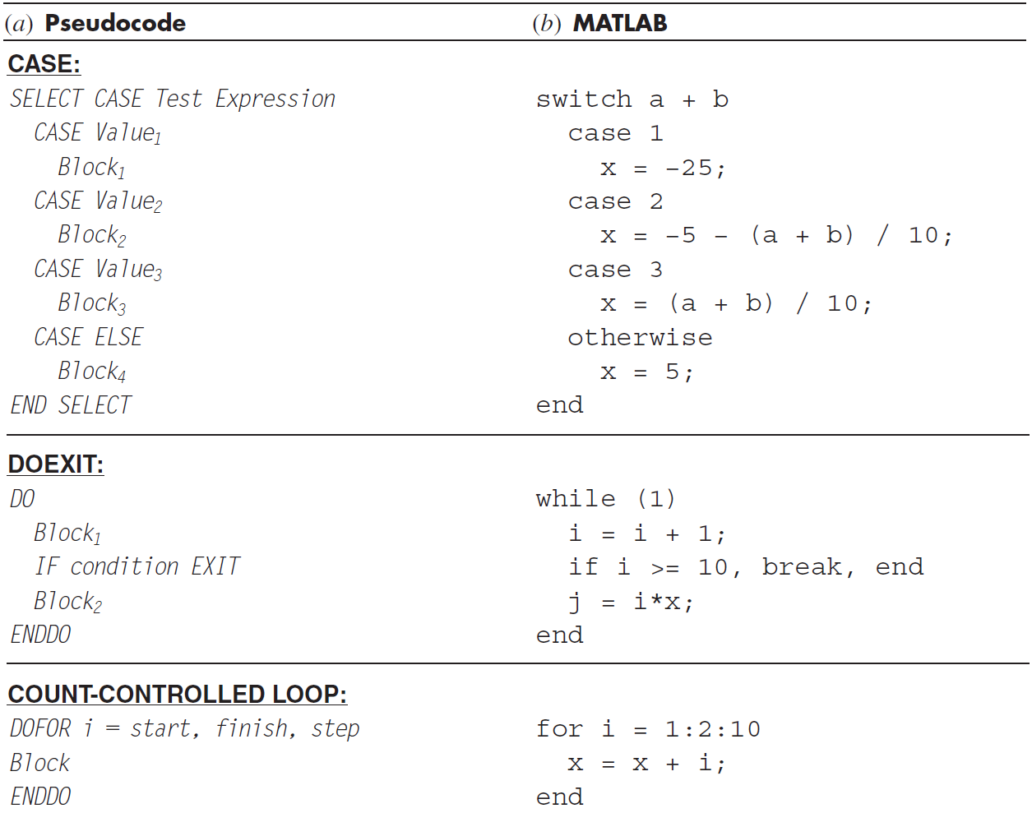

Slide 37
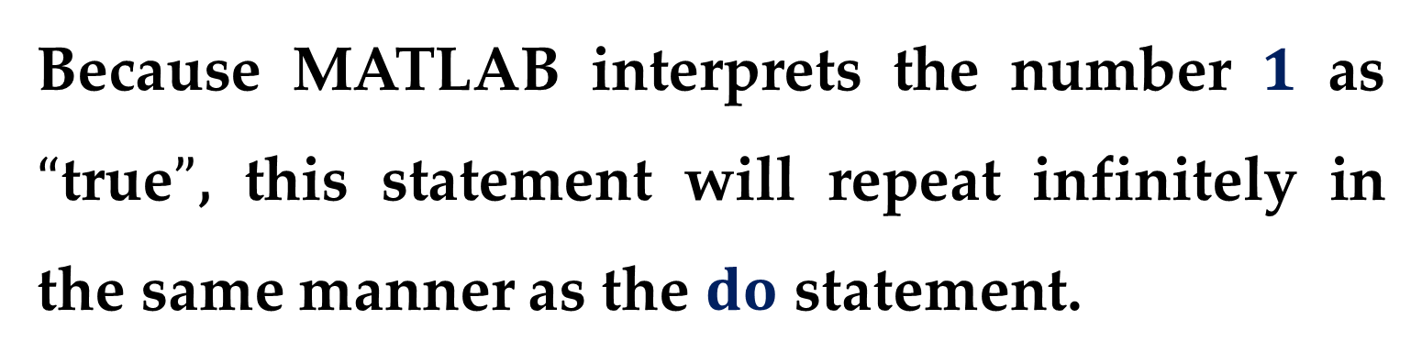
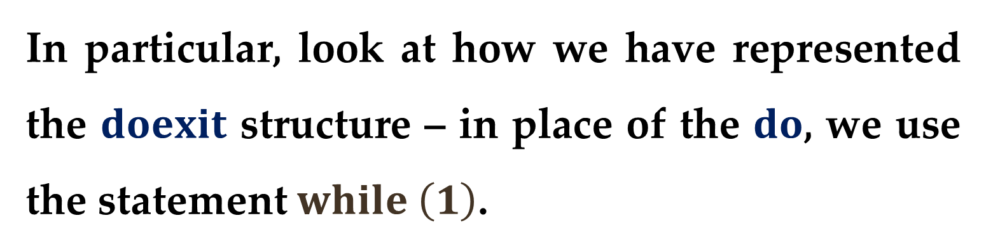
Although the structures of the pseudocode and the MATLAB code are very similar, there are some slight differences that should be noted.
In particular, look at how we have represented the $doexit$ structure – in place of the $do$, we use the statement $while \left(1\right)$.
Because MATLAB interprets the number $1$ as $“$true$”$, this statement will repeat infinitely in the same manner as the $do$ statement.

Slide 38
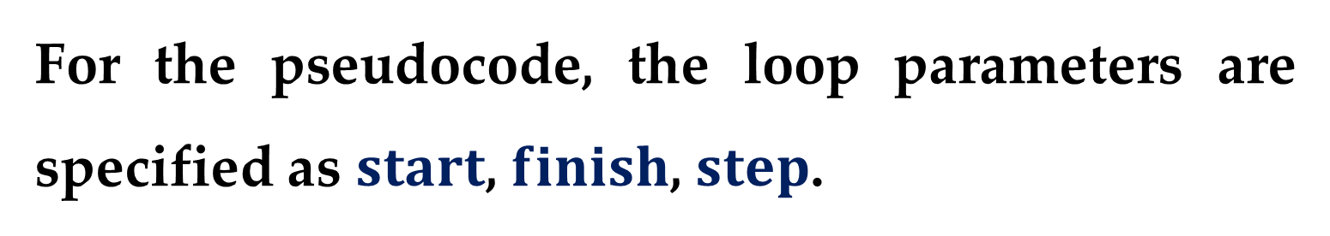

The loop is terminated with a $break$ command.
This command transfers control to the statement following the end statement that terminates the loop.
Also notice that the parameters of the count-controlled loop are ordered differently.
For the pseudocode, the loop parameters are specified as $start$, $finish$, $step$.

Slide 39



For MATLAB, the parameters are ordered as $start:step:finish$.
The following MATLAB $M−$file can now be developed directly from the pseudocode in $Figure 7$, which we should type into the MATLAB Editor/Debugger. 
Save this file as $numpara.m$ and return to the command mode and run it by entering: $numpara$.

Slide 40


The following output should result:
mass (kg): 100
velocity (m/s):
17.4559
As a final step in this development, let us take the above $M−$file and convert it into a proper function.

Slide 41


This can be done in the following $M−$file based on the pseudocode from $Figure 7$. 

Slide 42


Save this file as $euler.m$ and then create another $M−$file to compute the derivative:
function dydt = dy(t, v, m, cd)
g = 9.81;
dydt = g − (cd / m) * v;
Save this file as $dy.m$ and return to the command mode.

Slide 43
In order to invoke the function and see the result, you can type in the following commands:
>> m=68.1;
>> cd=12.5;
>> ti=0;
>> tf=2.;
>> vi=0;
>> dt=0.1;
>> euler(dt,ti,tf,vi,m,cd)

Slide 44

When the last command is entered, the answer will be displayed as:
ans =
16.5478
It is the combination of the MATLAB environment with the $M−$file programming language that truly opens up a world of possibilities for scientific and engineering problem solving.

Slide 45


MATHCAD
$Mathcad$ attempts to bridge the gap between spreadsheets like $Excel$ and notepads.
$Mathcad$ is essentially an interactive notepad that allows scientists and engineers to perform a number of common
mathematical$;$
data-handling$;$
graphical tasks.

Slide 46


Information and equations are input to a $“whiteboard”$ design environment that is similar in spirit to a page of paper.
Unlike a programming tool or spreadsheet$,$ $Mathcad′s$ interface accepts and displays natural mathematical notation using keystrokes or menu palette clicks — with no programming required.

Slide 47


Because the worksheets contain live calculations$,$ a single keystroke that changes an input or equation instantly returns an updated result.
$Mathcad$ can perform tasks in either $numeric$ or $symbolic$ mode. In $numeric$ mode$,$ $Mathcad$ functions and operators give numerical responses$;$ whereas in $symbolic$ mode results are given as general expressions or equations.

Slide 48

$Mathcad$ has a variety of functions and operators that allow convenient implementation of many of the numerical methods to be developed in this course.

Slide 49


Other Languages and Libraries
In previous sections$,$ we discussed how $Excel$ macros and $MATLAB$ procedures for Euler$’$s method could be developed from an algorithm expressed as pseudocode.
You should recognize that similar functions can be written in high-level languages like $Fortran,$ $Python,$ and C/C++.

Slide 50


For example$,$ a $Fortran 90$ function for Euler$’$s method is:

Slide 51



For C/C++$,$ the result would look quite similar to the $MATLAB$ function.
The point is that once a well-structured algorithm is developed in pseudocode form$,$ it can be readily implemented in a variety of programming environments.
In this course$,$ our approach will be to provide you with well-structured procedures written as pseudocode.

Slide 52
This collection of algorithms then constitutes a numerical library that can be accessed to perform specific numerical tasks in a range of software tools and programming languages.
Beyond your own programs, you should be aware that commercial programming libraries contain many useful numerical procedures.

Slide 53
Thank you for attention

Slide 54
text
text
text

Slide 55

$Solution$. $(continued)$
text
text
text

